Slide 1





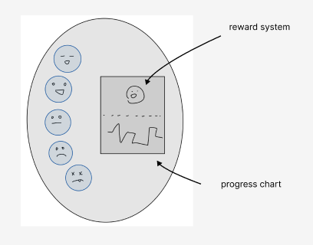


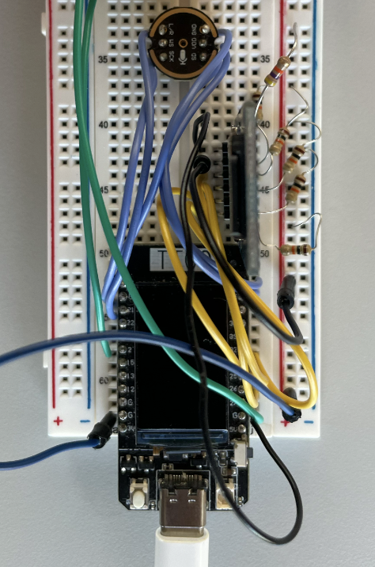


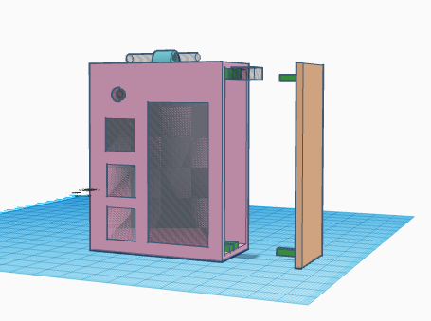
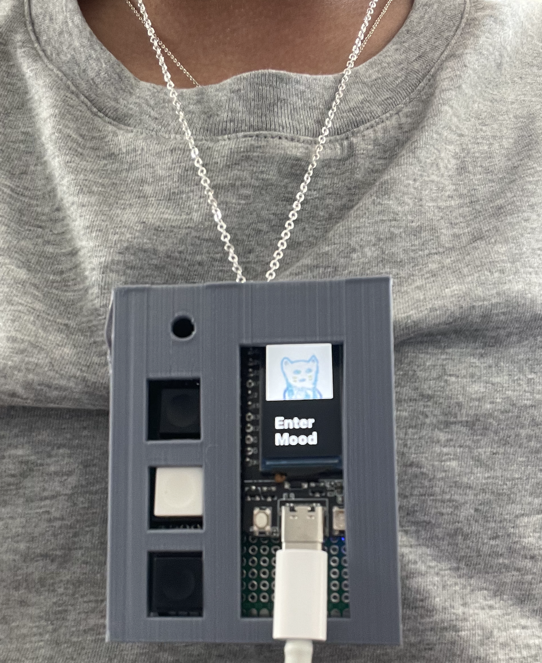

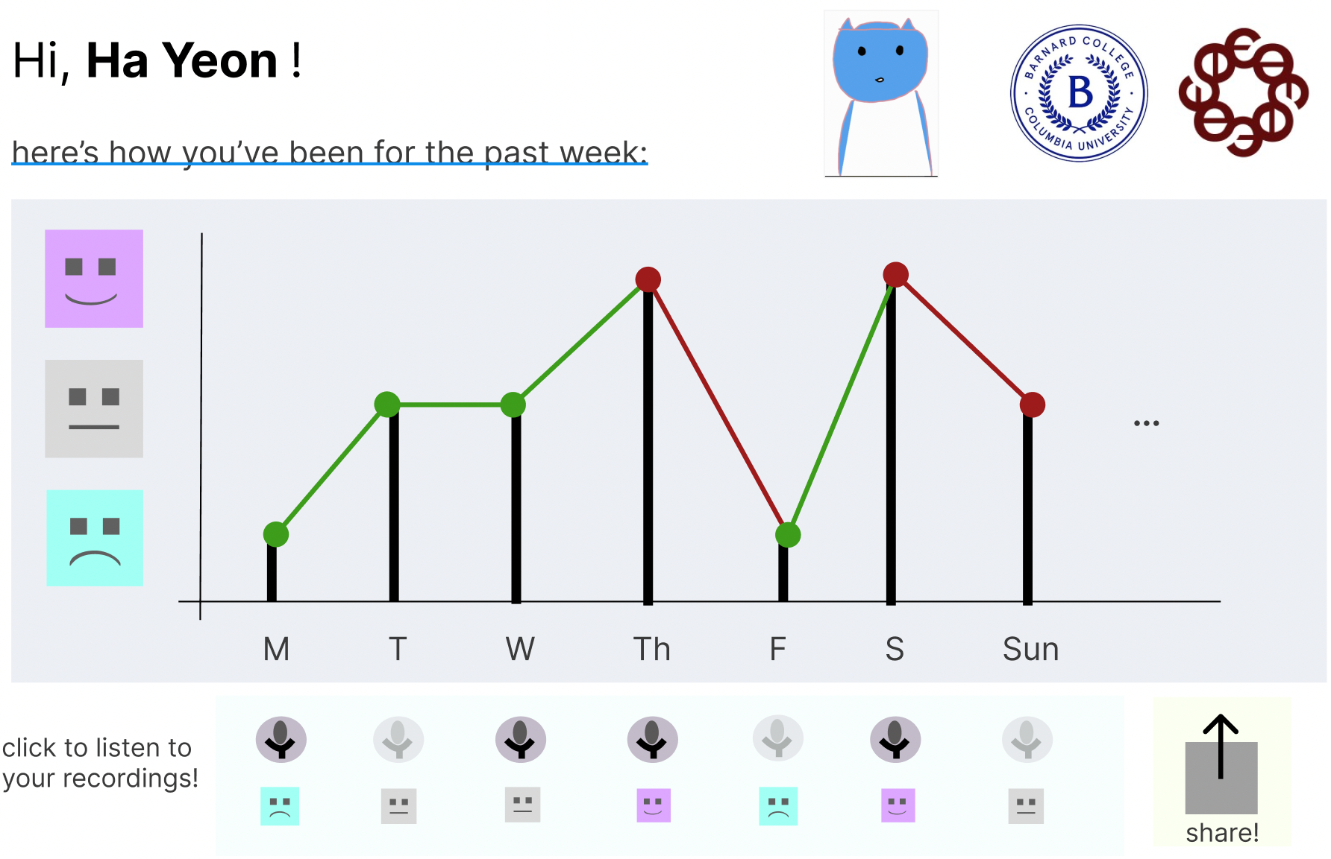
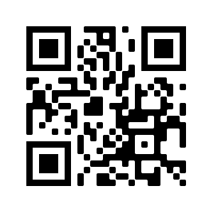
Creative Embedded Systems for Multi-Sensory Data Engagement
Ha Yeon Kim, Barnard College and Richard Lee, SEAS
Barnard Programming Languages Lab
Aim
To discover how low-power, low-cost devices can be deployed in local communities
to collect and display data effectively and inclusively
Proposal
Our project aims to develop a wellness tracker for homebound seniors to record their mood and make this data accessible to social workers.
Research Questions
Can construction of an affordable, efficient, interactive device promote engagement of senior citizens with technology and personal data?
What constitutes accessible, user-friendly hardware and software design?
Are there relative correlations between frequency of social engagement with reported well-being?
Tools
Hardware: ESP32, INMP441(microphone), buttons
Design: 3D printable model for enclosure
Software: Arduino IDE/ Platform IO
Total budget: ~$35.00
Using our device
The initial screen will ask how you feel.
And to use the device, user should click one of the three buttons which corresponds to numeric value 1,2, and 3 (assigned to happy, nothing, and sad).
Once the button is clicked, different image will appear and ask you to record a voice recording about your mood. This will be 30 seconds long.
After 30 seconds, the screen will confirm that the file is being saved and come back to the initial screen.
Mood data will be sent to our server and be used to provide monthly report for the users. Recorded files will be saved on micro-SD card attached to the device so that social workers can check the files if they have to.
Access data and recordings on server.
Procedure
Brainstorming
Prototyping
Design
Testing
Future Implementations
We hope this device can be used as a part of Emerest’s, a health care service company for homebound seniors based in New York, program to improve seniors’ mental health.
Deployment
Conclusion and Next Steps
For next step, we will be setting up a server to save the mood data and design a way to provide data back to the users. Our plan for now is to make a website that displays weekly and monthly mood of the user.
Acknowledgements
Professor Mark Santolucito
Barnard College SRI
Barnard Design Center
Scan for
Demo video
Reference
Aloha Hufana Ambe, Alessandro Soro, Daniel Johnson, and Margot Brereton. 2022. From Collaborative Habituation to Everyday Togetherness: A Long-Term Study of Use of the Messaging Kettle. ACM Trans. Comput.- Hum. Interact. 29, 1, Article 3 (January 2022)
Department of Computer Science, Barnard College of Columbia University
It is a pleasure to acknowledge support for this research from Barnard College
Notes:
design process + brainstorming

